Slide 1
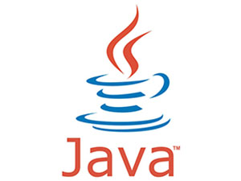
Java for Beginners
University Greenwich
Computing At School
DASCO
Chris Coetzee

Slide 2
What do I need for Java?
JDK
IDE
Java!
JDK (Java Development Kit) – download from Oracle
IDE (Integrated Development Environment) Many options:
Eclipse (eclipse.org) – PC and Mac version
BlueJ (bluej.org)
Netbeans (netbeans.org) ALL FREE!

Slide 3
3 Laws of Java
Every line ends with a ; unless the next symbol is a {
Every { has a }
Classes start with capital letters, methods and variables start with lower case letters

Slide 4
Syntax rules
Classes start capital letters and have no ( )
Methods start lowercase letters and have a ( )
Variables always start with a lowercase letter
= means ‘gets the value of’
== means ‘equals’ when comparing numbers
.equals() means ‘equals’ when comparing words

Slide 5
Java’s structure
Java programs are called ‘classes’
They exist inside a container called a project
All classes have at least one method called main()
Project: CheeseCake
Class: CheeseCake
Method: main()
We write our ‘code’ here

Slide 6
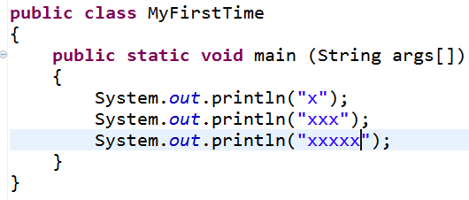
Java class example

Slide 7
Java class example
Class name
Main method

Slide 8
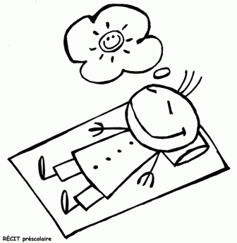
Don’t worry!
The IDE (Eclipse) automatically makes all the ‘gunk’ at the top public this, void main that…

Slide 9
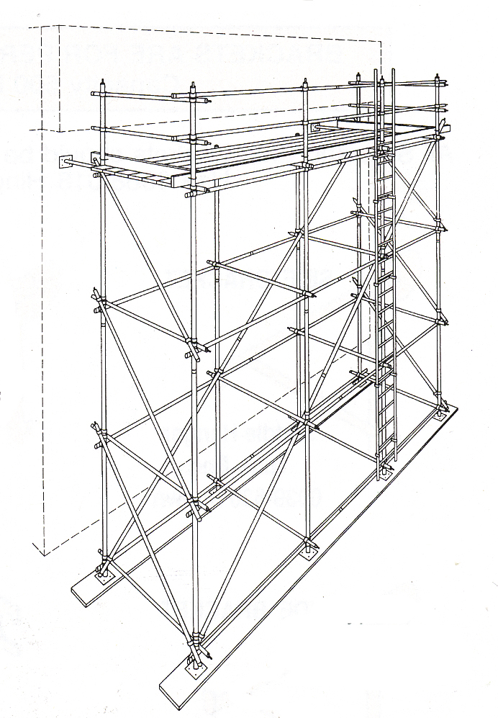
Levels of coding
Learning to program can be difficult if you don’t learn things in the right order.
Each level depends on a firm understanding of the previous level.
It works!

Slide 10
Levels of Java coding
1: Syntax, laws, variables, output
2: Input, calculations, String manipulation
3: Selection (IF-ELSE)
4: Iteration/Loops (FOR/WHILE)
5: Complex algorithms
6: Arrays
7: File management
8: Methods
9: Objects and classes
10: Graphical user interface elements

